Slide 1
Sels Analytics Project
Power bi

Slide 2
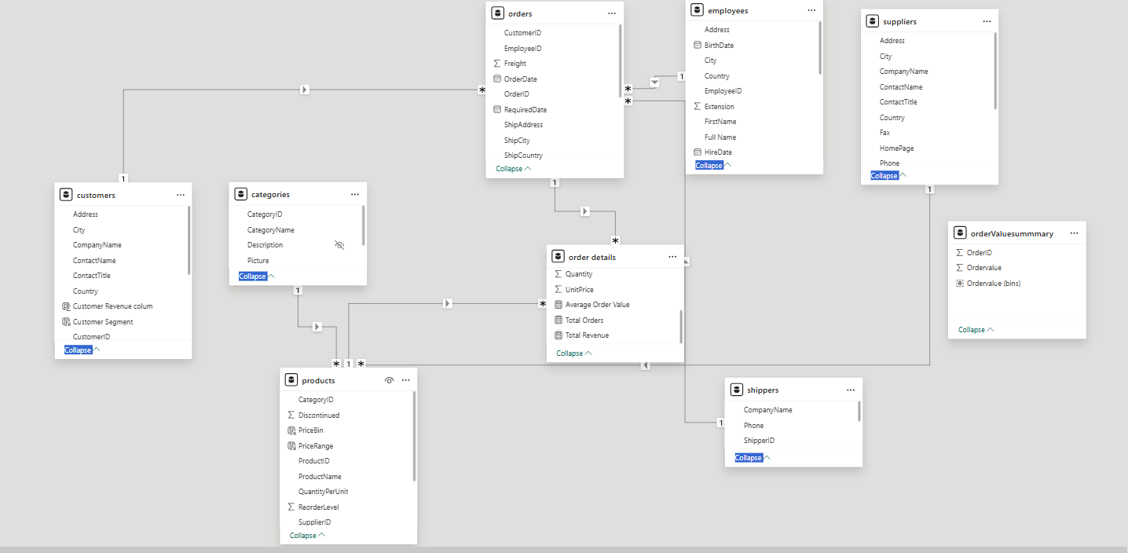

Slide 3
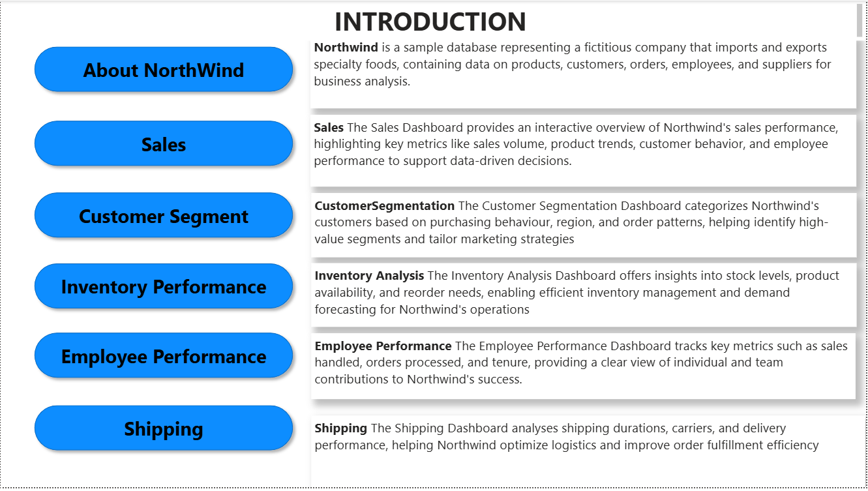

Slide 4
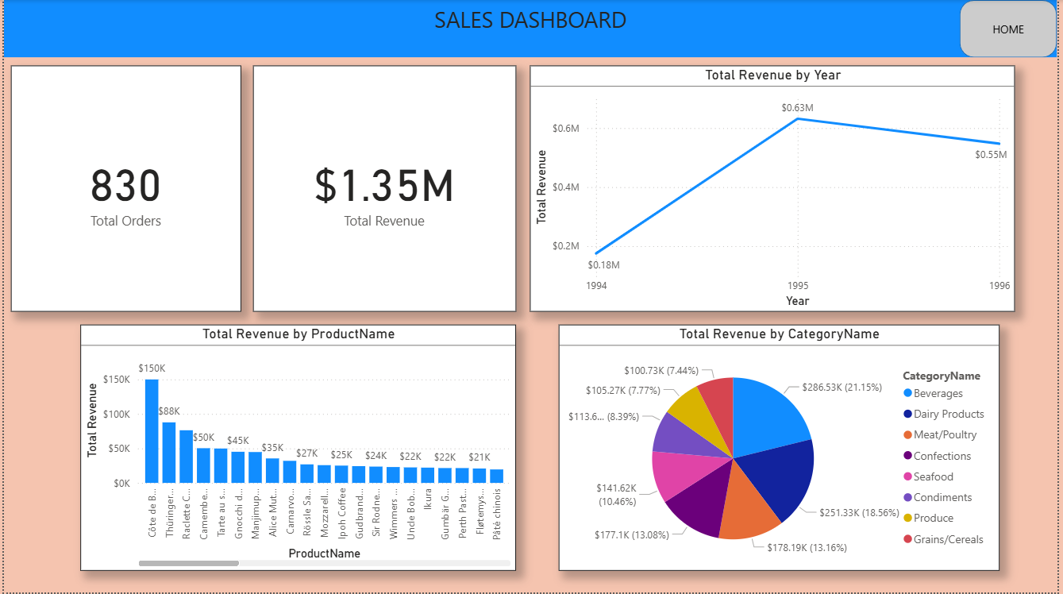

Slide 5
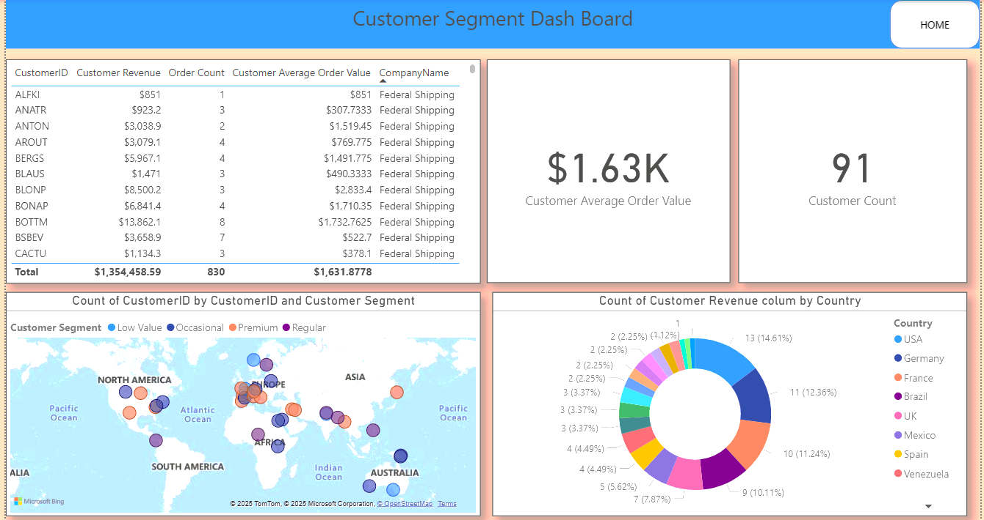

Slide 6
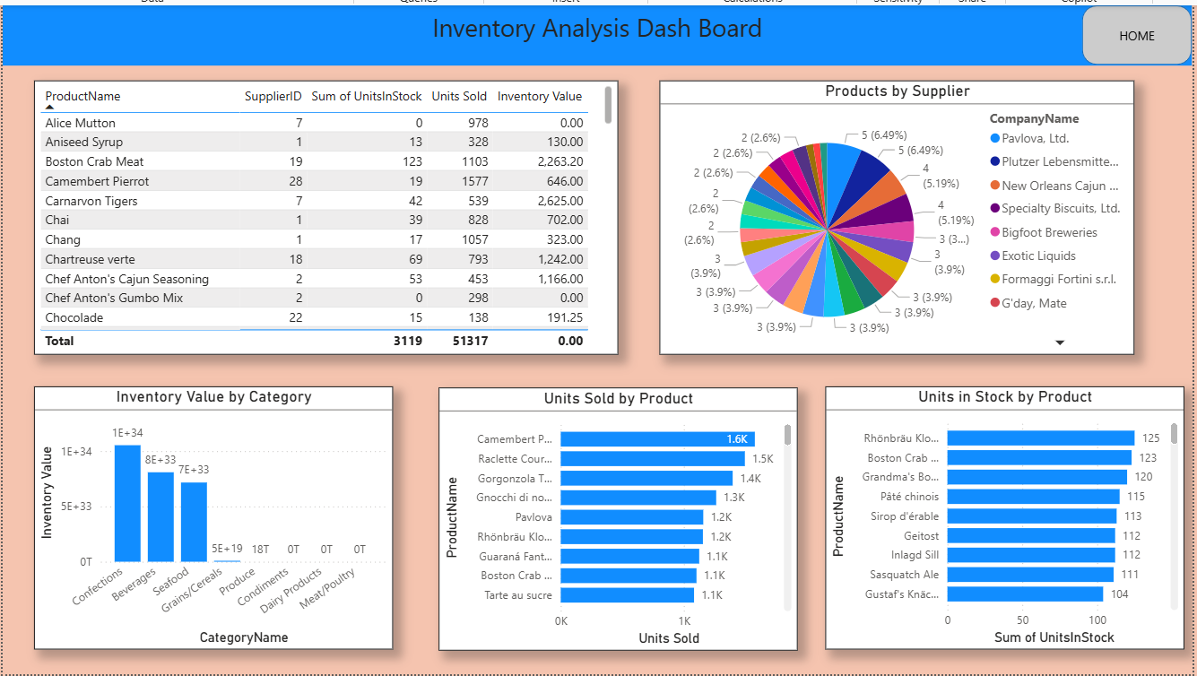

Slide 7
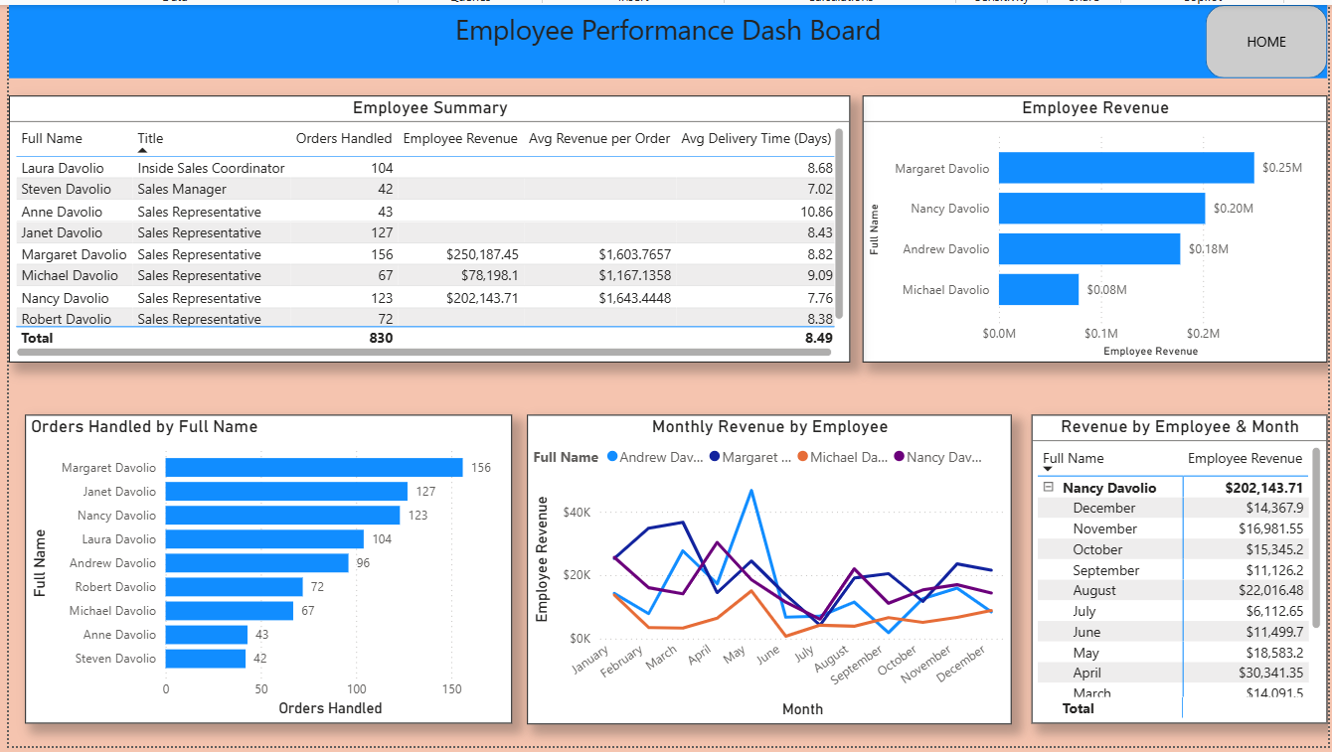

Slide 8
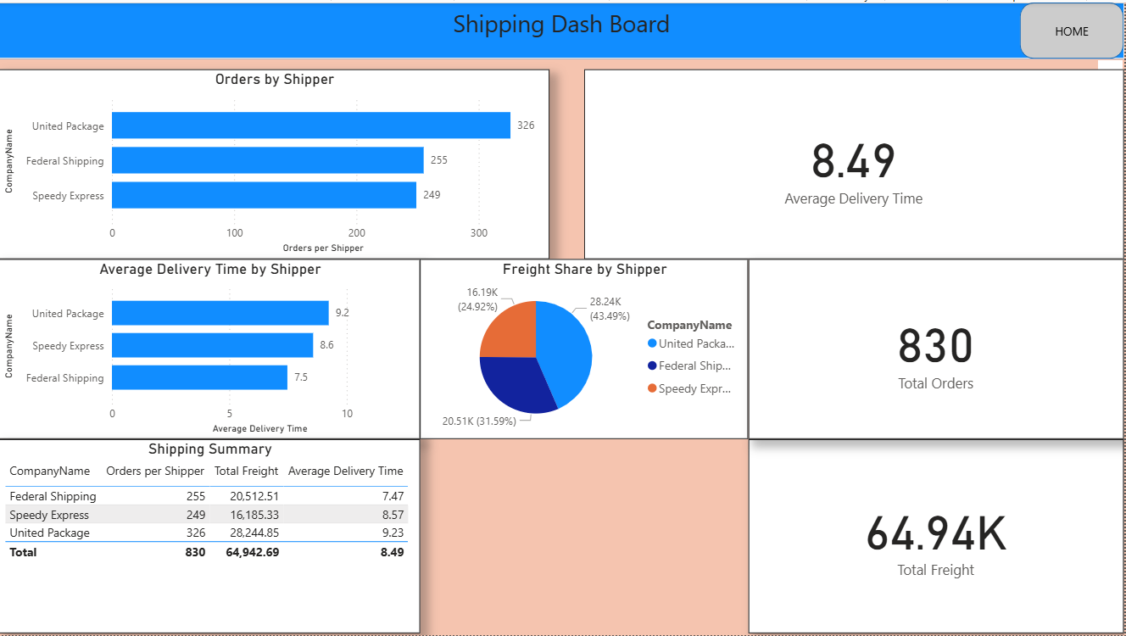

Slide 9
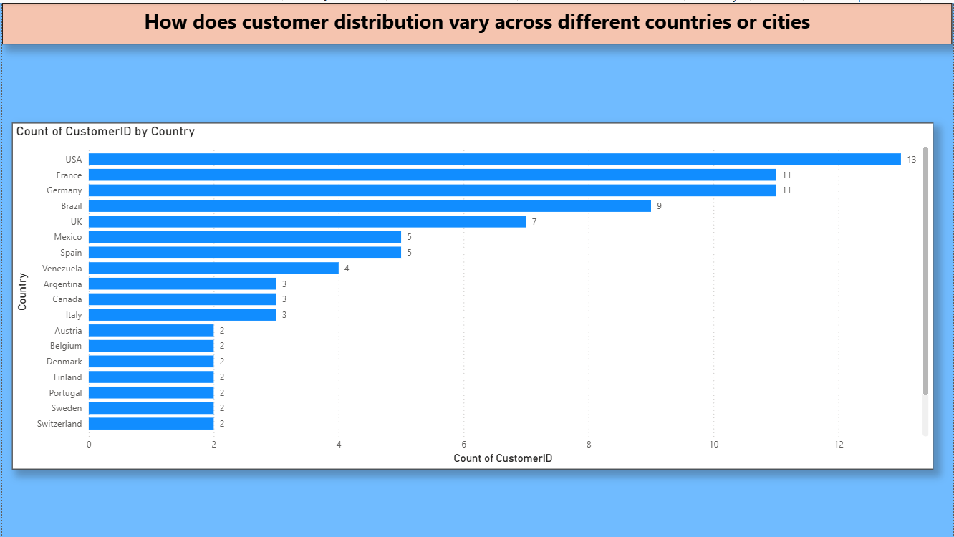
Conclusion
Key Insights:
USA has the highest customer count (13), making it the largest market segment in this dataset.
France and Germany follow closely with 11 customers each, suggesting strong market presence in Western Europe.
Other notable markets include:
Brazil (9 customers)
UK (7 customers)
Mexico and Spain (5 each)
Countries such as Switzerland, Sweden, Portugal, and others have a much lower customer base (2 each), indicating untapped or emerging markets.
Business Implications:
Focus retention and loyalty strategies in USA, France, and Germany to safeguard the core customer base.
Explore growth strategies in mid-tier countries like Brazil, UK, and Mexico, where potential expansion could yield high returns.
Consider targeted marketing and partnerships in low-volume countries to increase presence and engagement.

Slide 10
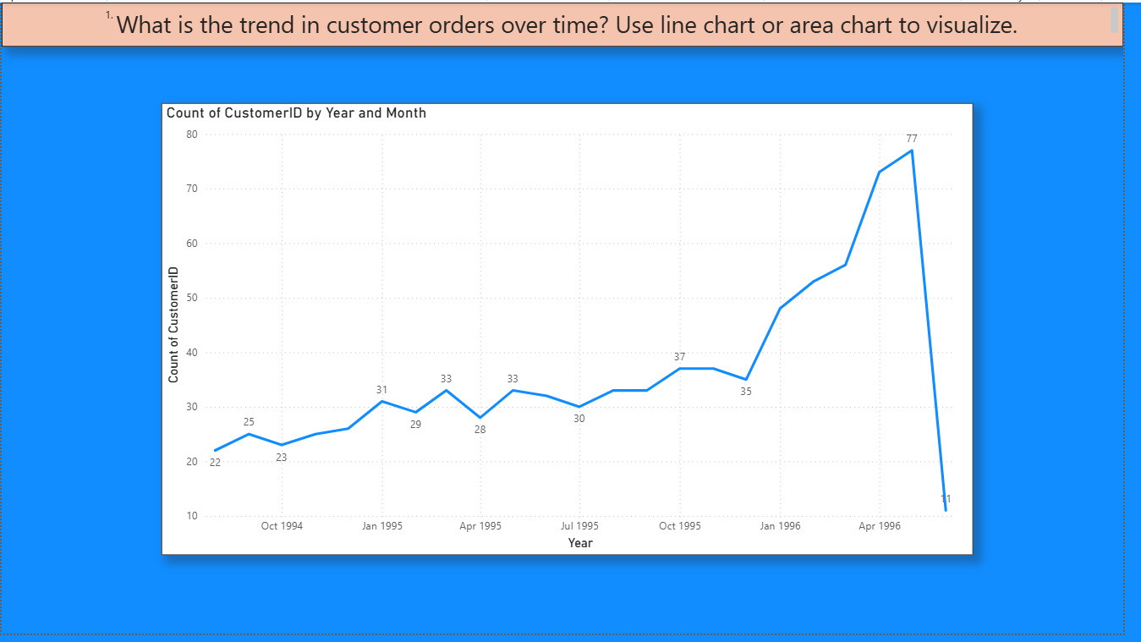
Conclusion
The overall trend reflects positive growth in customer engagement and order volume until mid-1996, followed by an anomalous drop likely caused by data incompleteness rather than actual performance decline. Further validation of data for late 1996 is recommended.

Slide 11
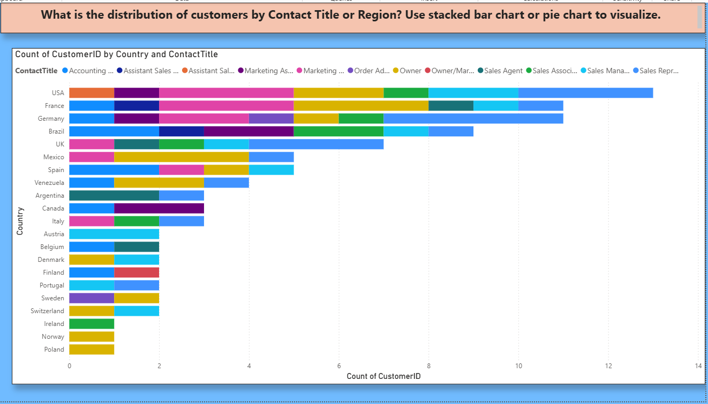
Conclusion
The customer base is geographically diverse, with strong representation from North America and Western Europe. The Sales Representative role dominates the contact title distribution, indicating that most business interactions occur through sales personnel. Countries with a higher variety of contact titles may reflect more complex or mature customer organizations. Further analysis could explore how these roles impact sales volume or customer lifetime value.

Slide 12
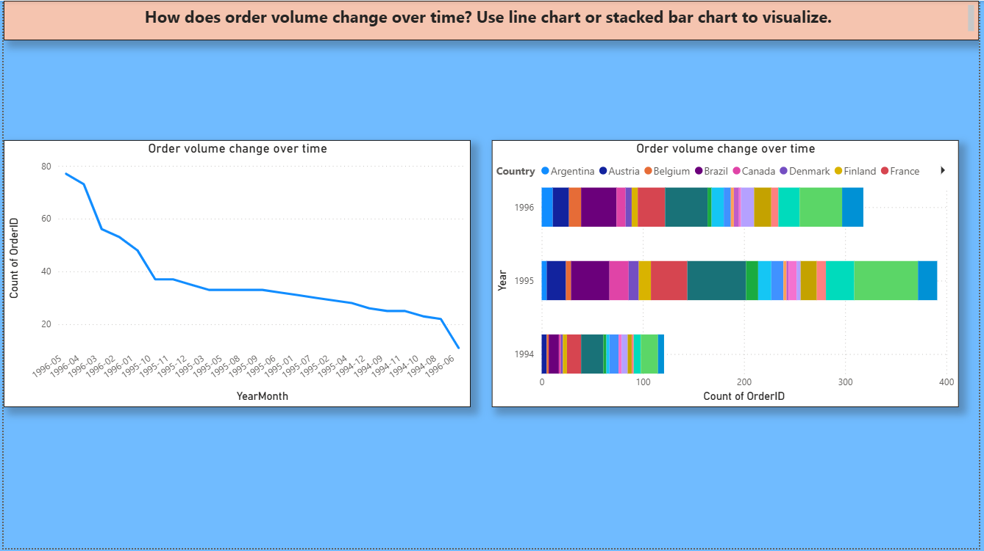
Conclusion
The customer base is geographically diverse, with strong representation from North America and Western Europe. The Sales Representative role dominates the contact title distribution, indicating that most business interactions occur through sales personnel. Countries with a higher variety of contact titles may reflect more complex or mature customer organizations. Further analysis could explore how these roles impact sales volume or customer lifetime value.

Slide 13
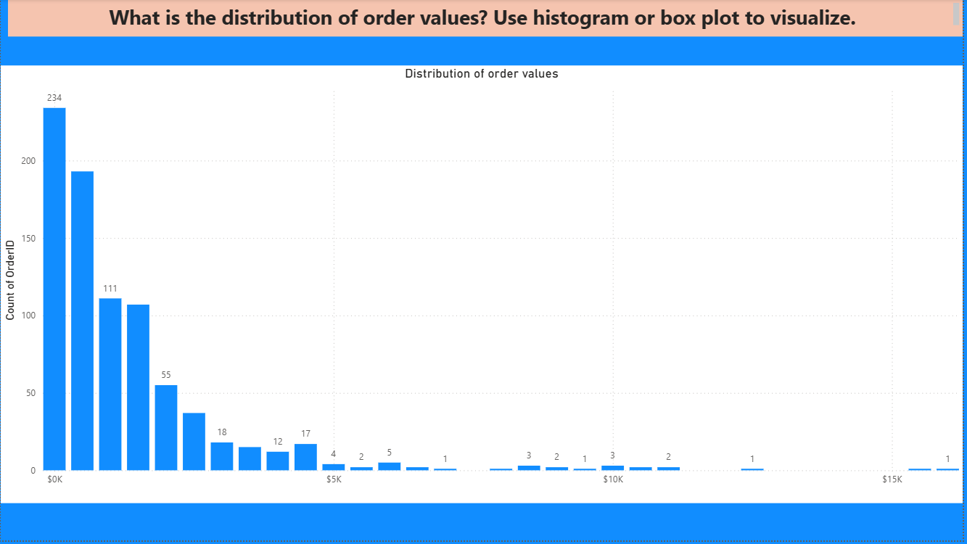
Conclusion
Most customer orders are of relatively low value, with a few high-value transactions significantly increasing the spread. This indicates that while the business has some large-scale buyers, the majority of transactions are small to medium in size. Identifying and analyzing these high-value orders could help in targeting key customers or understanding bulk purchasing behavior.

Slide 14
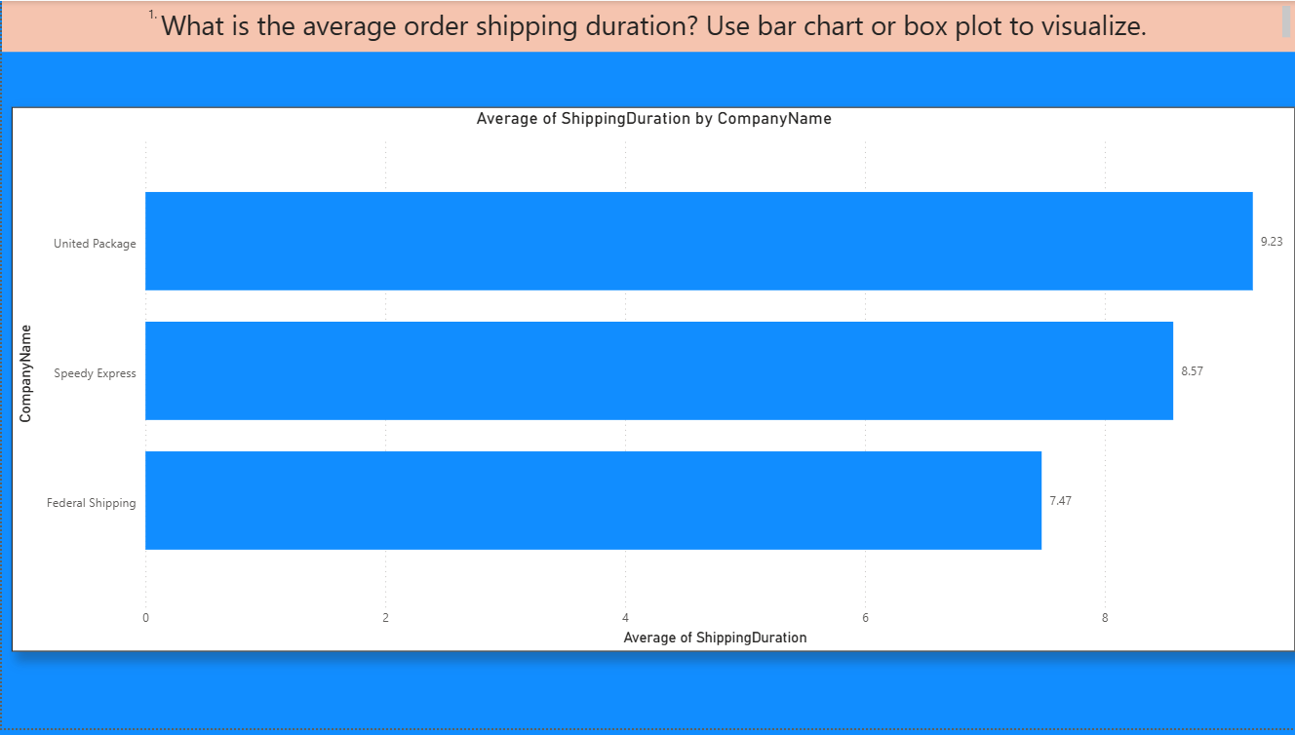
Conclusion
Federal Shipping is the most efficient, with the shortest average shipping time of 7.47 days.
United Package is the slowest on average, taking over 9 days.
If shipping speed is a priority, Federal Shipping would be the best choice among the three.

Slide 15
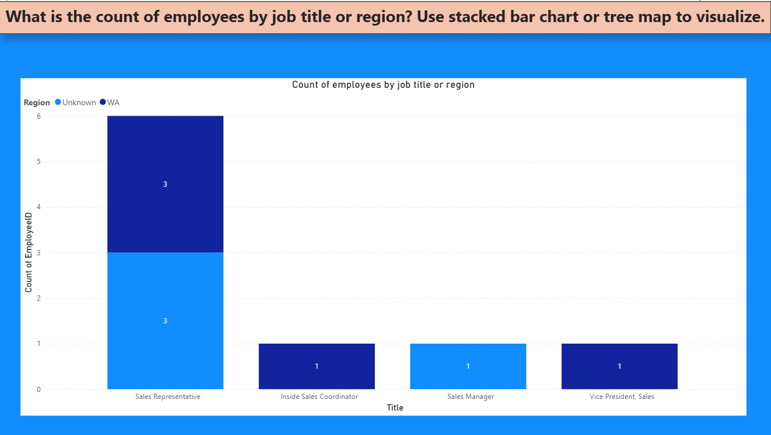
Conclusion
Sales Representative is the most common jobtitle
Spread across multiple regions, with notable representation in both "WA" and "Unknown" regions.
Indicates the company's focus on direct sales operations.
Vice President, Sales and Inside Sales Coordinator each have one representative, showing specialized or leadership roles are rare.
"Unknown" region values highlight missing or incomplete data
It may be beneficial to clean or enrich this data to better understand geographic distribution.
WA Region dominates most roles

Slide 16
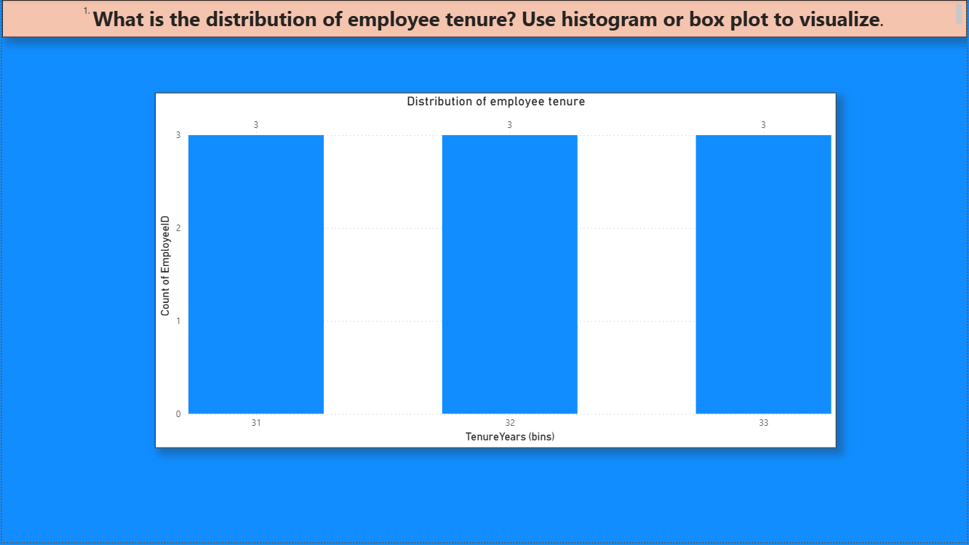
Conclusion
The histogram shows that employee tenure is distributed fairly evenly across three tenure ranges: 31, 32, and 33 years. Each bin has exactly 3 employees, indicating:
There is no significant variation in employee tenure.
The workforce seems to consist mainly of long-tenured employees, suggesting high retention and organizational loyalty.
This may reflect a stable workforce with experienced personnel, though it could also indicate a lack of new hires or younger talent.

Slide 17
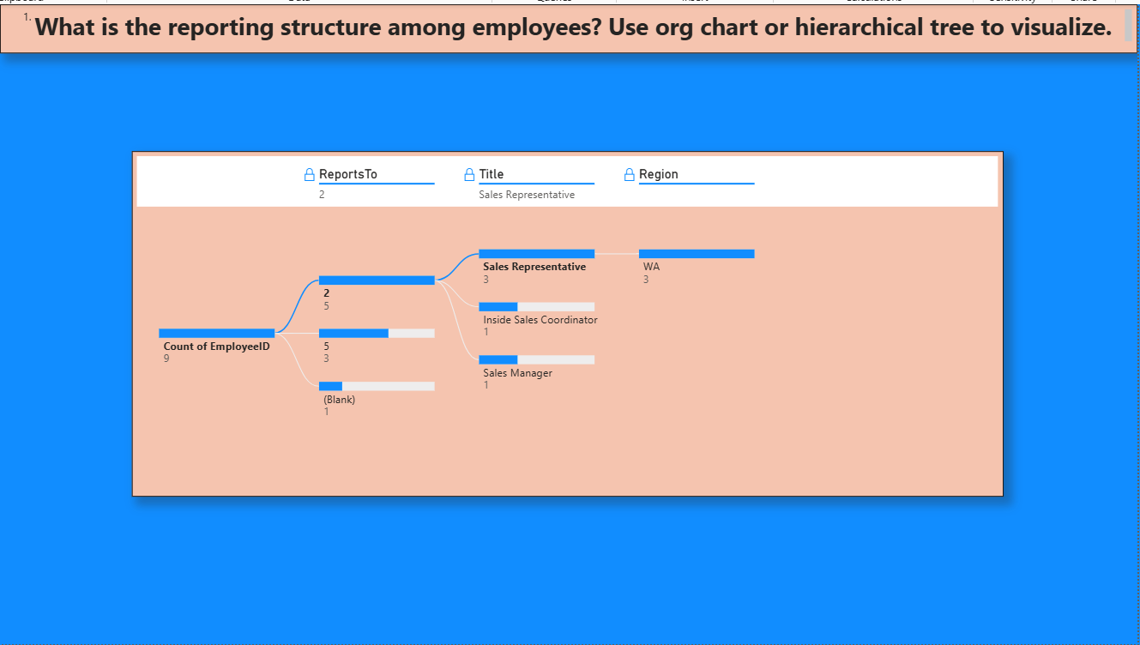
Conclusion
Manager with Employee ID = 2 oversees 5 employees, including:
3 Sales Representatives in the WA region
1 Inside Sales Coordinator
1 Sales Manager
Employee ID = 5 supervises 3 employees, whose roles are not further specified here.
There is 1 employee with no reporting manager, possibly the top-level executive

Slide 18
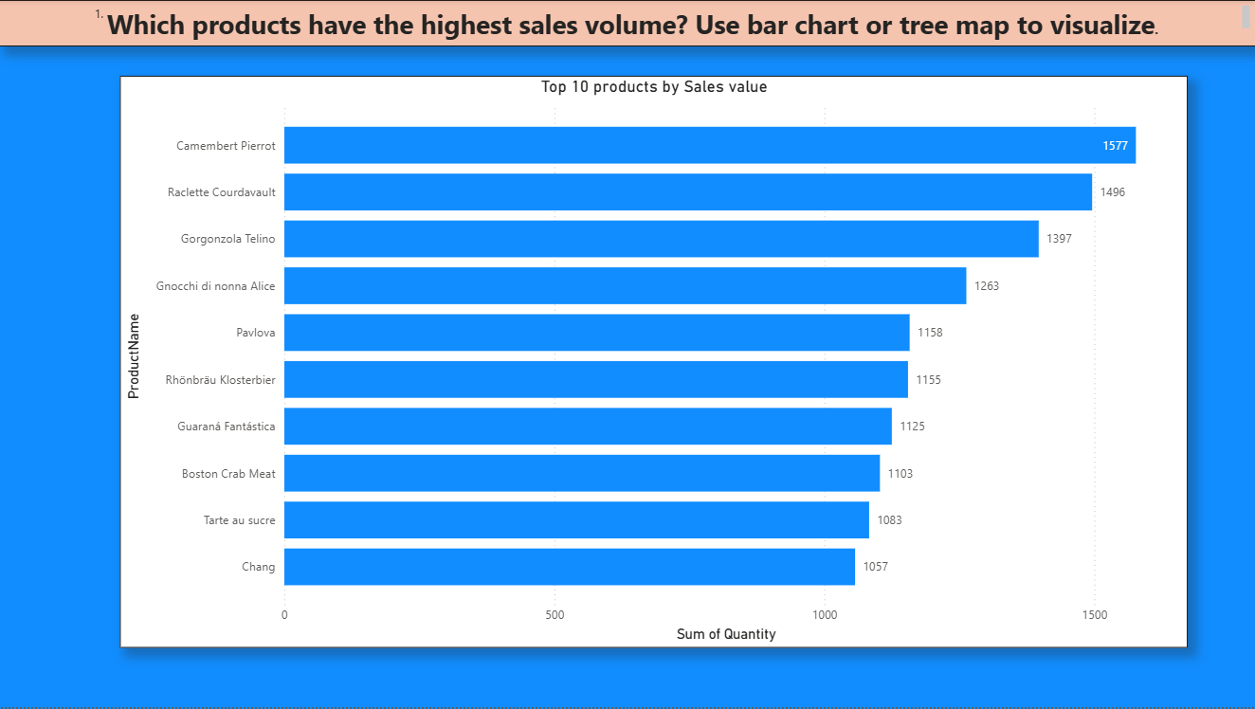
Conclusion
Cheese products dominate the top ranks, showing high customer preference.
There's a gradual decline in sales volume from the top product down to the tenth.
Products like Chang (1,057 units) and Tarte au sucre (1,083 units) round out the top performers but lag behind the leaders by ~500 units.

Slide 19
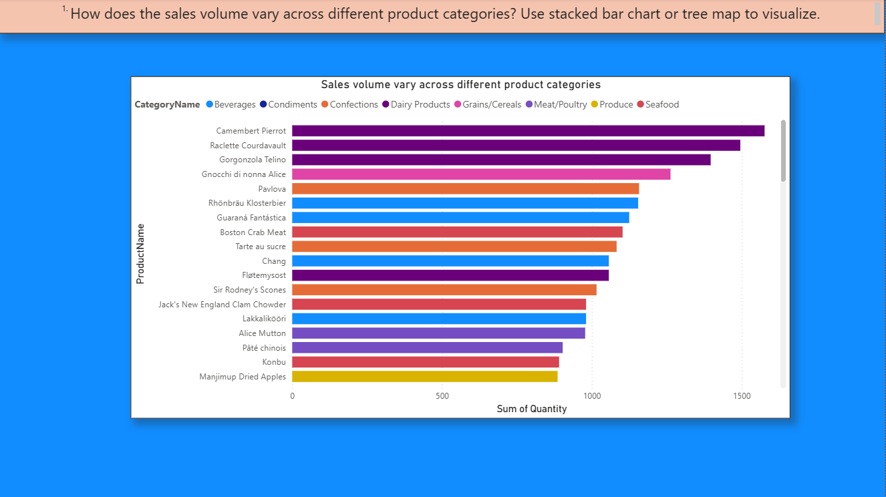
Conclusion
Dairy Products lead in volume, indicating strong customer demand.
Confections and Beverages follow closely, making them important for marketing and inventory planning.
A balanced performance across various categories highlights the value of a diversified product portfolio.

Slide 20
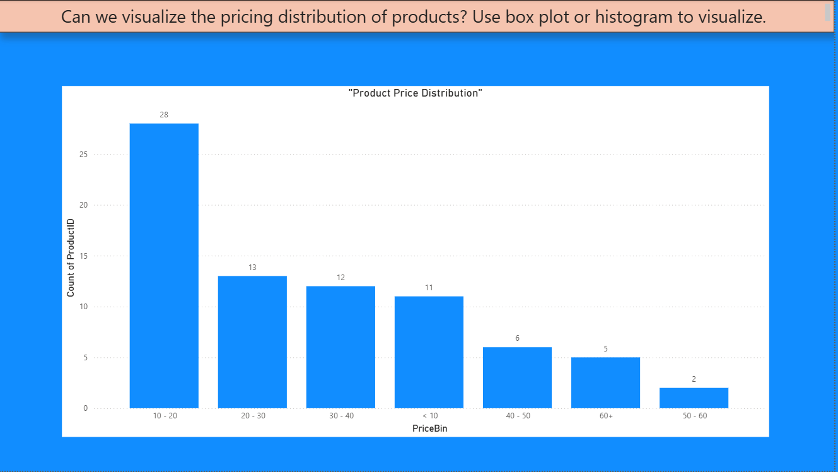
Conclusion
The distribution is right-skewed (more products at lower prices).
Most products are priced under $30, showing a focus on affordability.
There are very few high-end products, which might indicate a gap or a deliberate market strategy depending on customer demand.

Slide 21
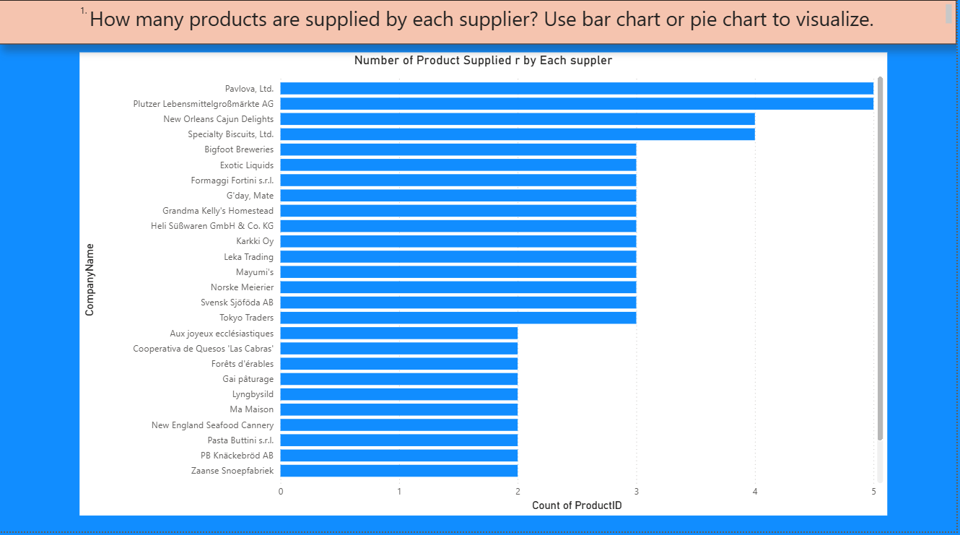
Conclusion
Top Suppliers:
Pavlova, Ltd. and Plutzer Lebensmittelgroßmärkte AG each supply 5 products — the highest among all.
Close behind are:
New Orleans Cajun Delights and Specialty Biscuits, Ltd. with 4 products each.
Widespread Contribution:
A majority of other suppliers (like Bigfoot Breweries, Formaggi Fortini s.r.l., Exotic Liquids, etc.) contribute 3 products each.
This suggests a relatively balanced supply base.
Smaller Suppliers:
Several suppliers (such as PB Knäckebröd AB, Ma Maison, Tokyo Traders, etc.) supply only 2 products,
indicating either niche offerings or limited catalogs.

Slide 22
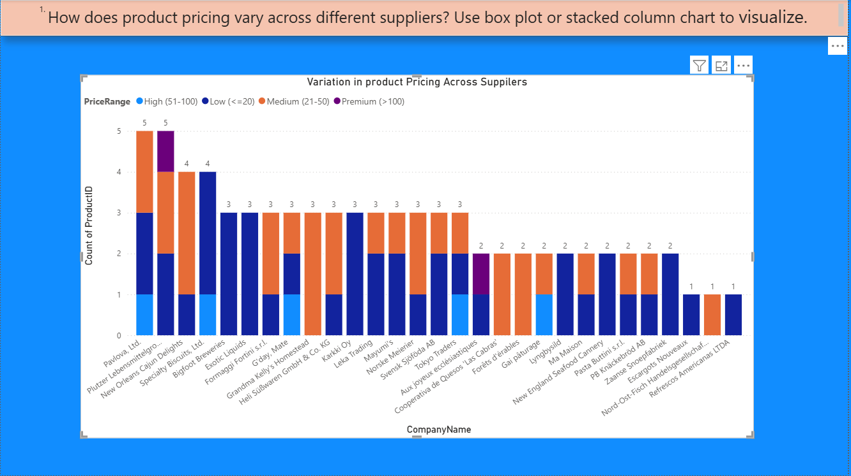
Conclusion
The stacked column chart reveals that product pricing varies significantly across suppliers. Most suppliers predominantly offer medium-priced products ($21–$50), indicating this is the most common pricing tier. A few suppliers, such as Pavlova, Ltd. and Plutzer Lebensmittelgroßmärkte AG, offer a diverse product mix across all price ranges, including premium-priced products (above $100), suggesting a broader market reach.
On the other hand, several suppliers like Bigfoot Breweries, Svensk Sjöföda AB, and Exotic Liquids focus on low to medium price ranges, potentially targeting cost-conscious consumers. Only a handful of suppliers provide premium products, which could reflect specialized or high-quality offerings.
Overall, the pricing distribution suggests a market dominated by medium-priced products, with select suppliers differentiating themselves through premium or diverse pricing strategies

Slide 23
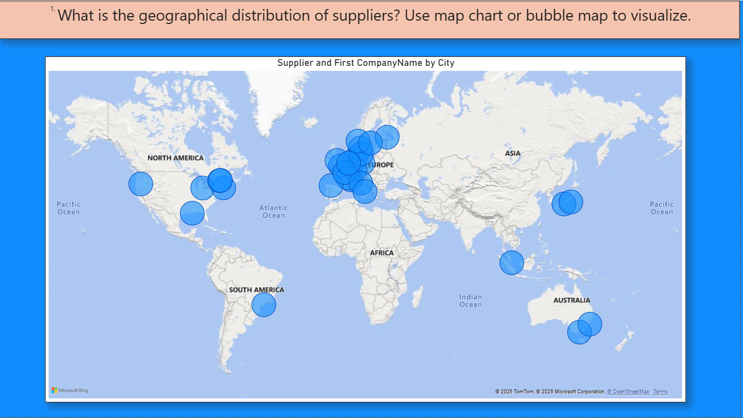
Conclusion
The bubble map clearly shows that suppliers are concentrated in Europe and North America, indicating these regions are the primary hubs for product sourcing.
Europe has the highest supplier density, with numerous cities contributing to the supply network—suggesting strong regional manufacturing and export capabilities.
North America, particularly the USA and Mexico, also hosts several suppliers, supporting a robust North American supply chain.
Suppliers are less frequent in regions like Asia, South America, and Australia, though they are still represented, showing a moderate global reach.
Africa appears to have no supplier representation in this dataset.

Slide 24
Sels Analytics Project
EDA

Slide 25
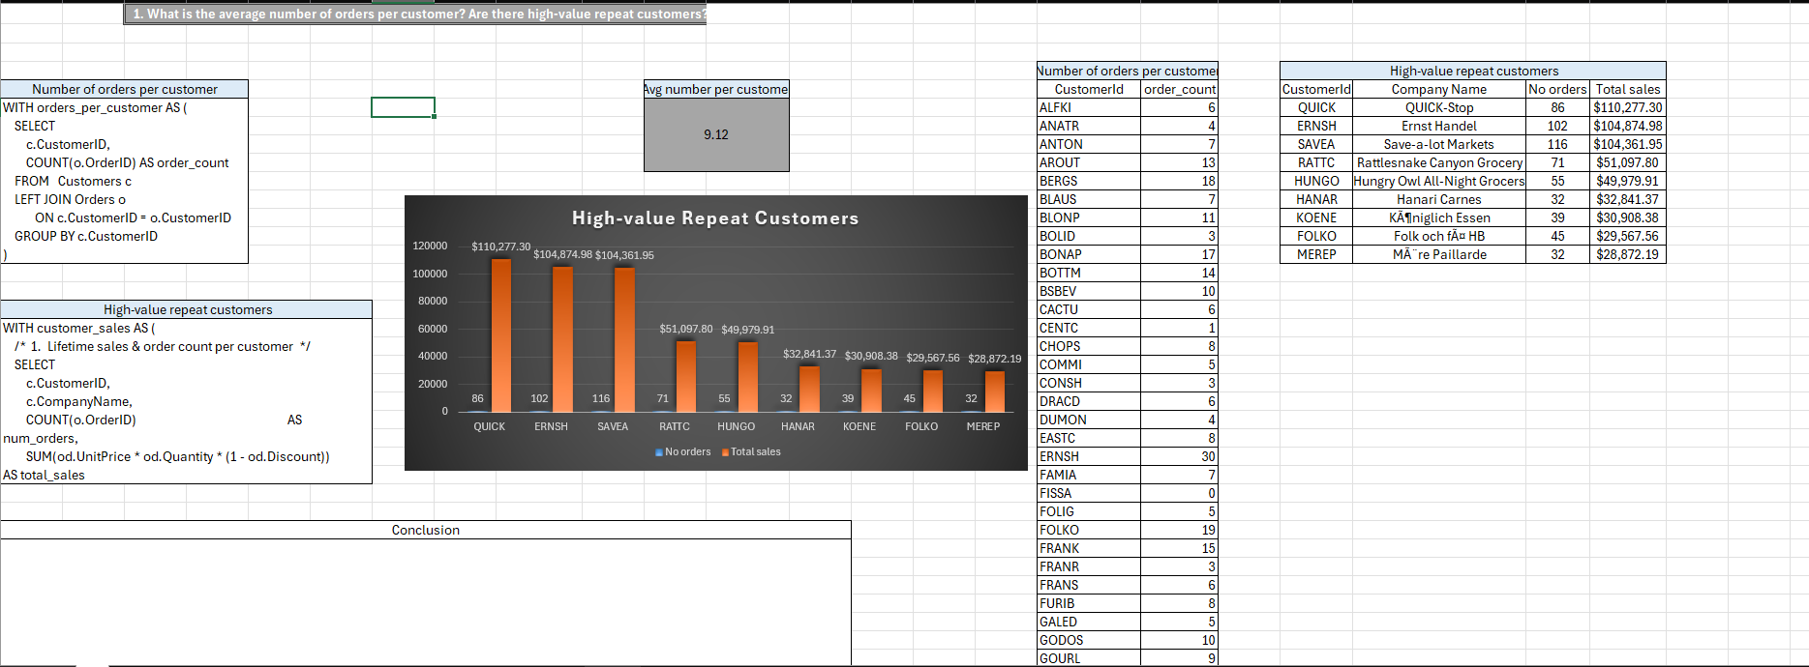

Slide 26
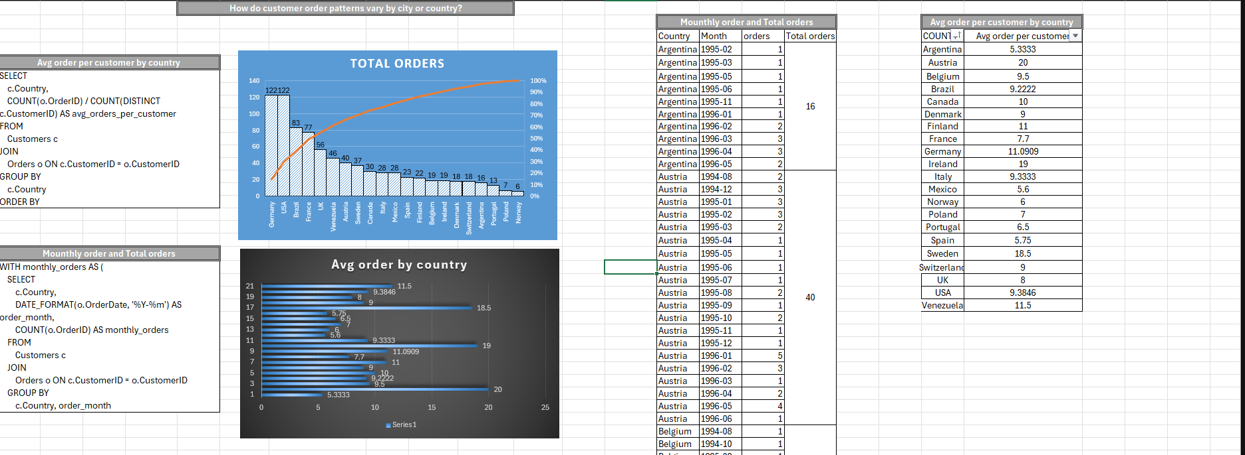

Slide 27
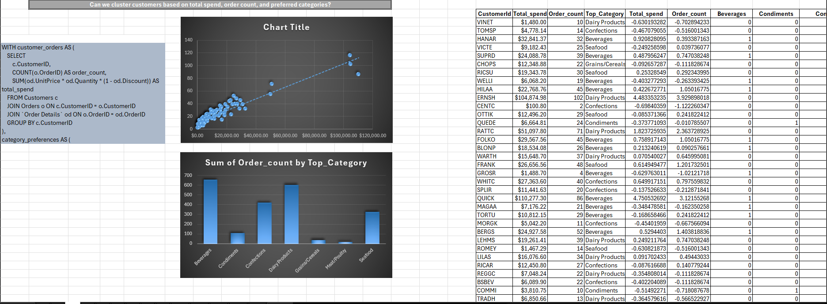

Slide 28
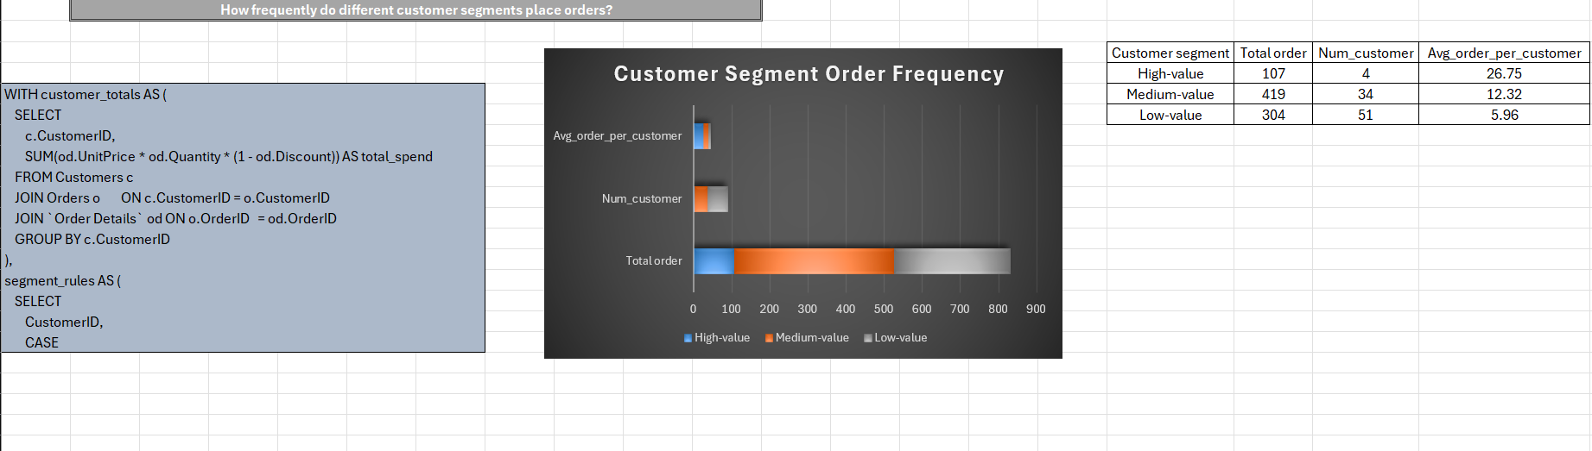

Slide 29
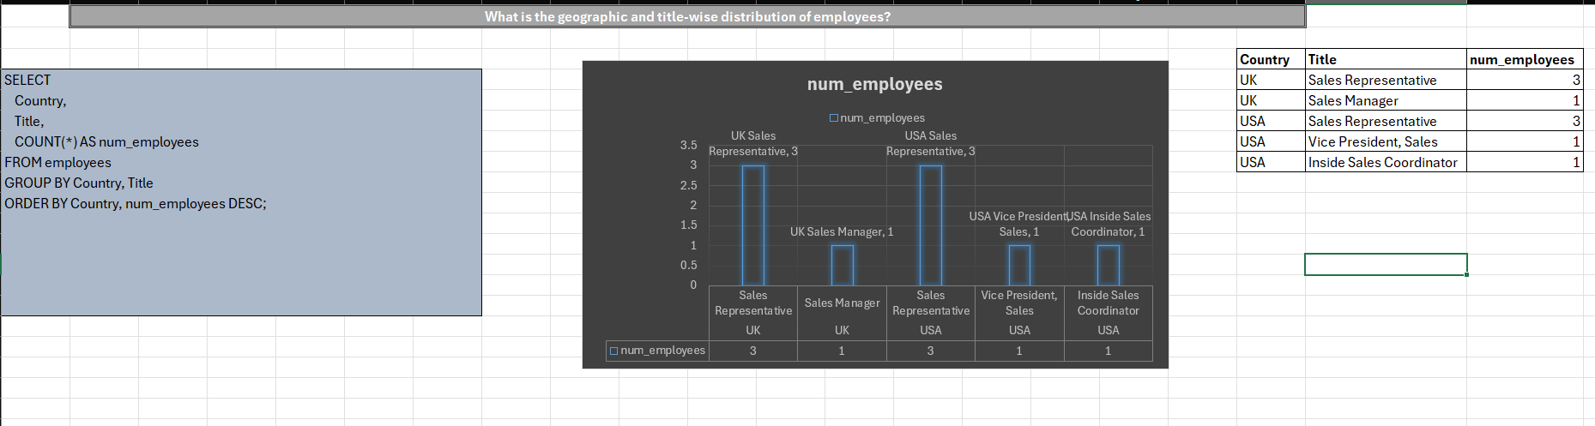

Slide 30
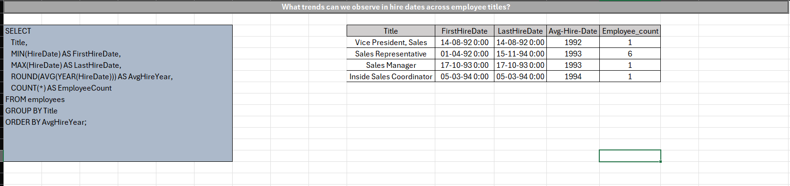

Slide 31
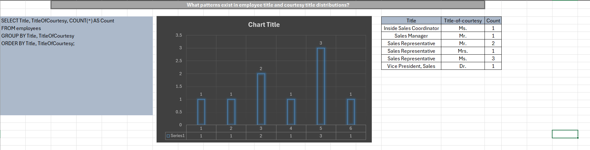

Slide 32
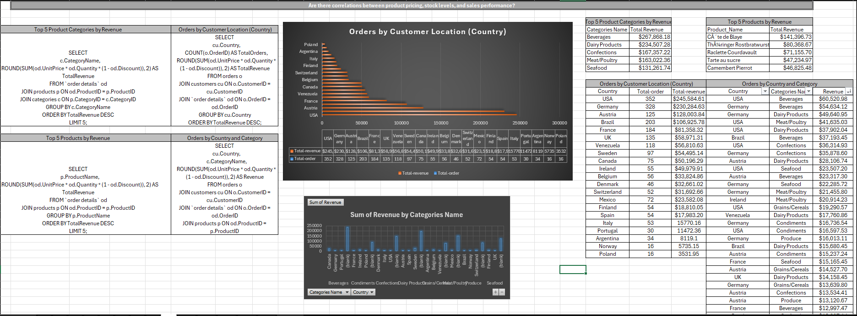

Slide 33
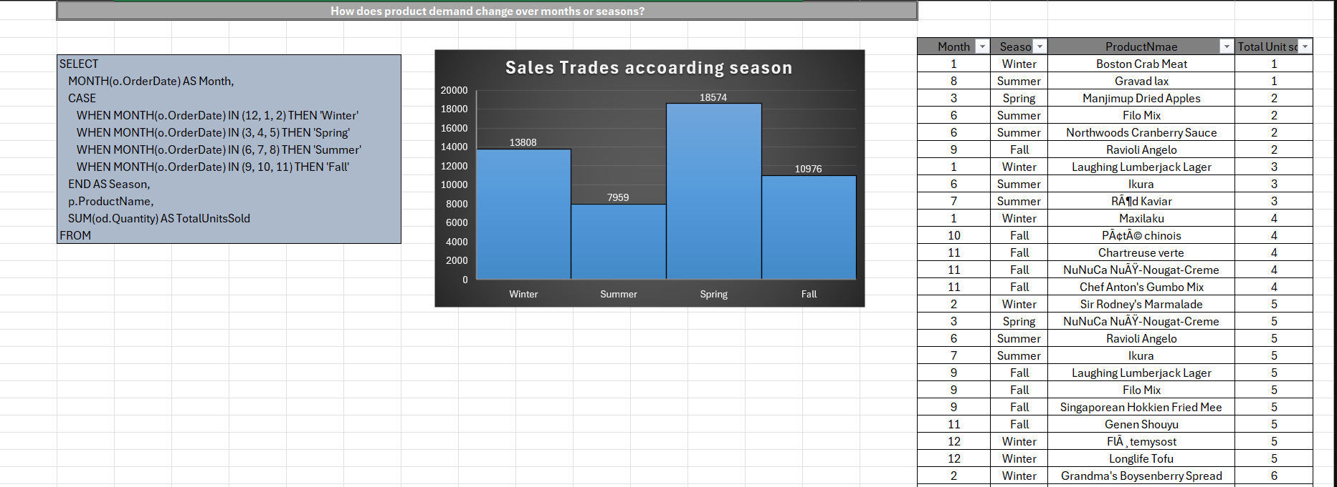

Slide 34
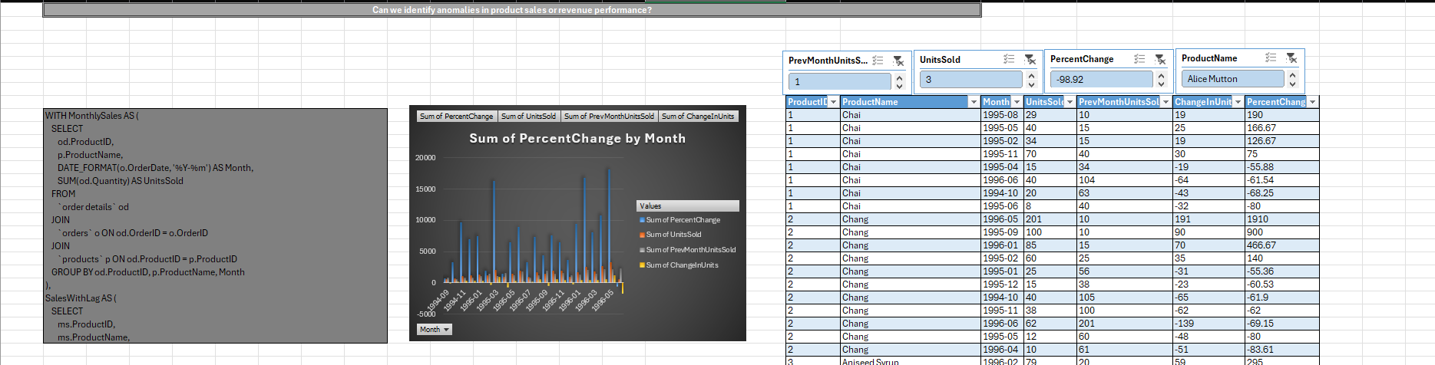

Slide 35
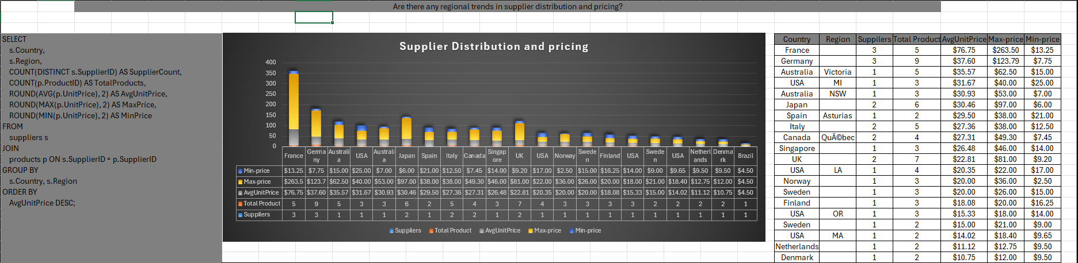

Slide 36
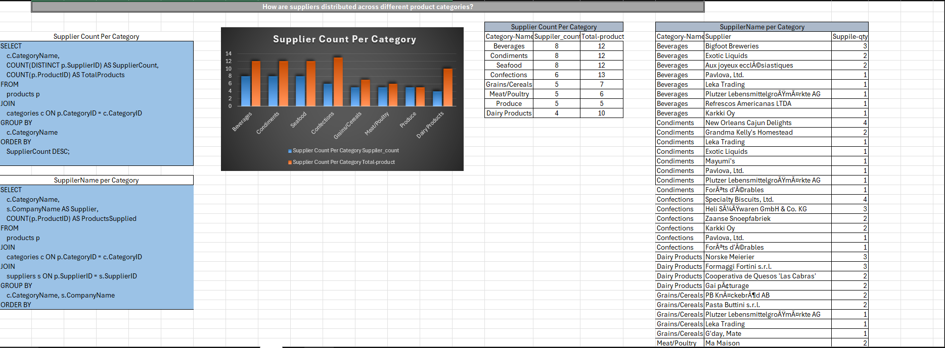

Slide 37
